Slide 1
Generative Networks for Satellite Image Data
N. Kostagiolas

Slide 2
A little bit about me
BSc in Informatics & Telecommunications, University of Athens
  Thesis: “Study on the structure of chromatin via nucleosome pattern recognition using n-gram graphs”
  i.e. “does DNA textual information (a.k.a. DNA first-level structure) regulate nucleosome presence (inhibition vs. encouragement)?”
MSc in Data Science, Athens University of Economics & Business
  Thesis: “Learning optimization algorithms w/ neural networks”
  i.e. “can we possibly make machines to learn more efficiently? And what are the limits of this?”
  A.k.a. Meta-learning or learning-to-learn.
As of October, 2020:
  PhD student, CaSToRC Unit. Advisor: Mihalis A. Nicolaou
  Working at the intersection between Generative Modeling and Remote Sensing.

Slide 3
What is Machine Learning?
Arthur Samuel (1959)
“… gives computers the ability to learn without being explicitly programmed”
Tom Mitchell (90s)
“the study of computer algorithms that improve automatically through experience”
A more formal one:
“A computer program is said to learn from experience E with respect to some class of tasks T and performance measure P if its performance at tasks in T, as measured by P, improves with experience E”
In essence
Machine learning is the science of learning models from data, for making predictions and decisions

Slide 4
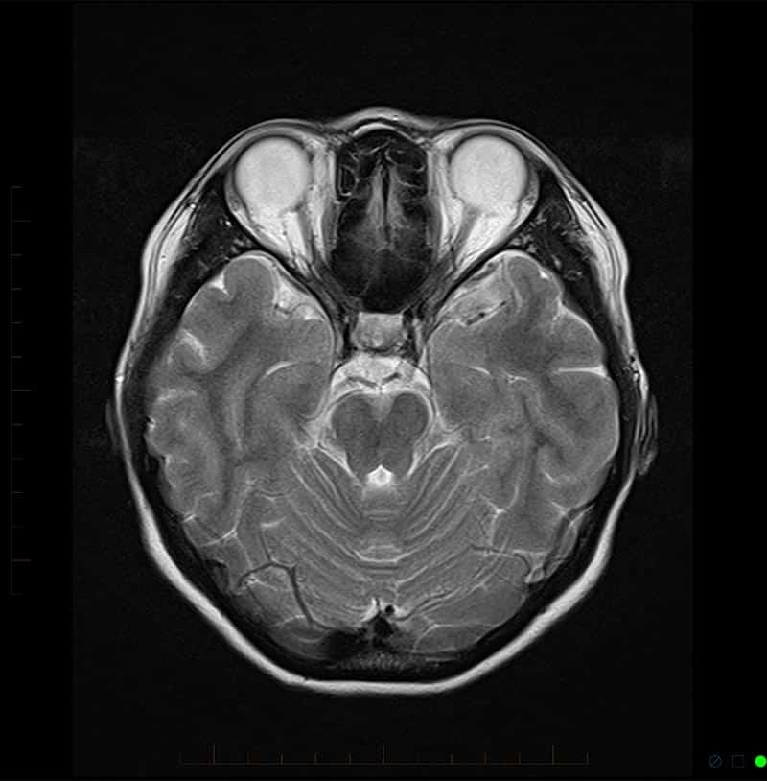

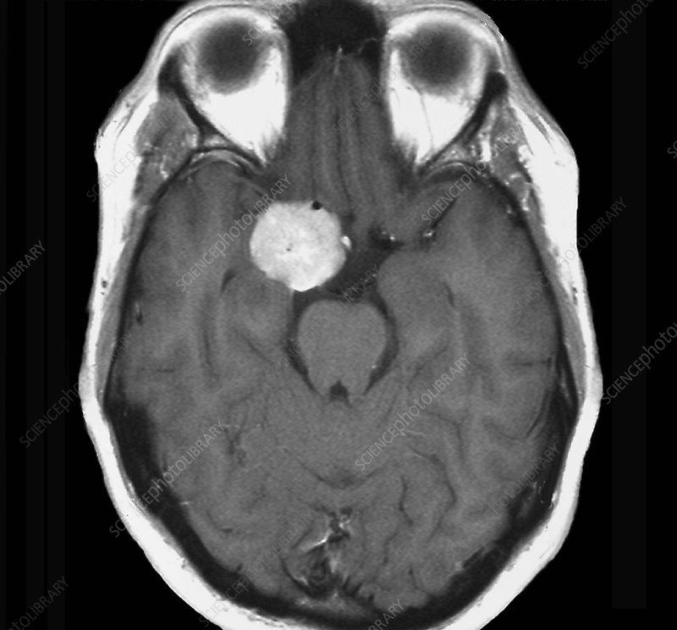
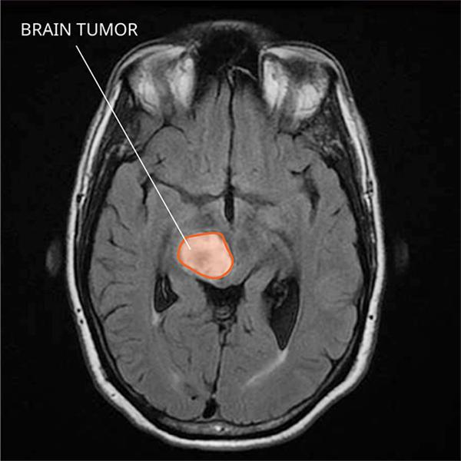
Traditional Programming vs. Machine Learning
DATA
OUTPUT (presence of tumour, malignancy, etc.)
PROGRAM
(usually if-then-else rules)
DATA
OUTPUT
(e.g. segmentation map)
PROGRAM that, when provided with an unseen MRI
outputs the appropriate seg. map

Slide 5
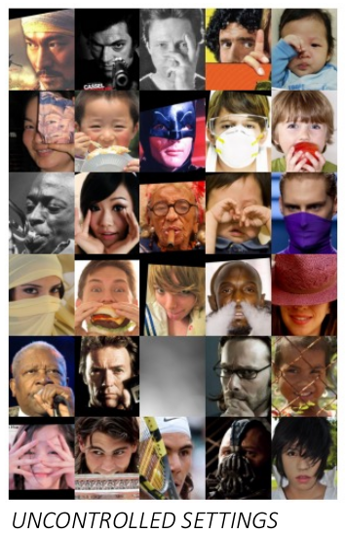
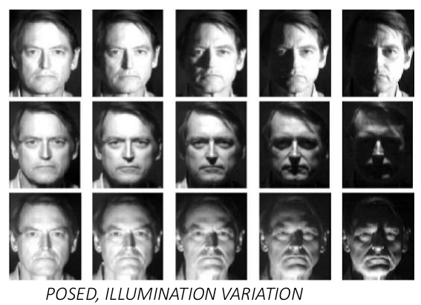
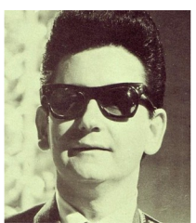
Aside from the macabre…
There exists knowledge that we can not describe with if-then rules
More generally, in many cases we simply do not know the function that maps a problem state to a solution
This is also largely due to the vast variability and noise manifesting in real-world data/problems (e.g., in faces: illumination, pose, expression)
Also, tacit or implicit knowledge
POSED, ILLUMINATION VARIATION
OCCLUSION
UNCONTROLLED SETTINGS

Slide 6
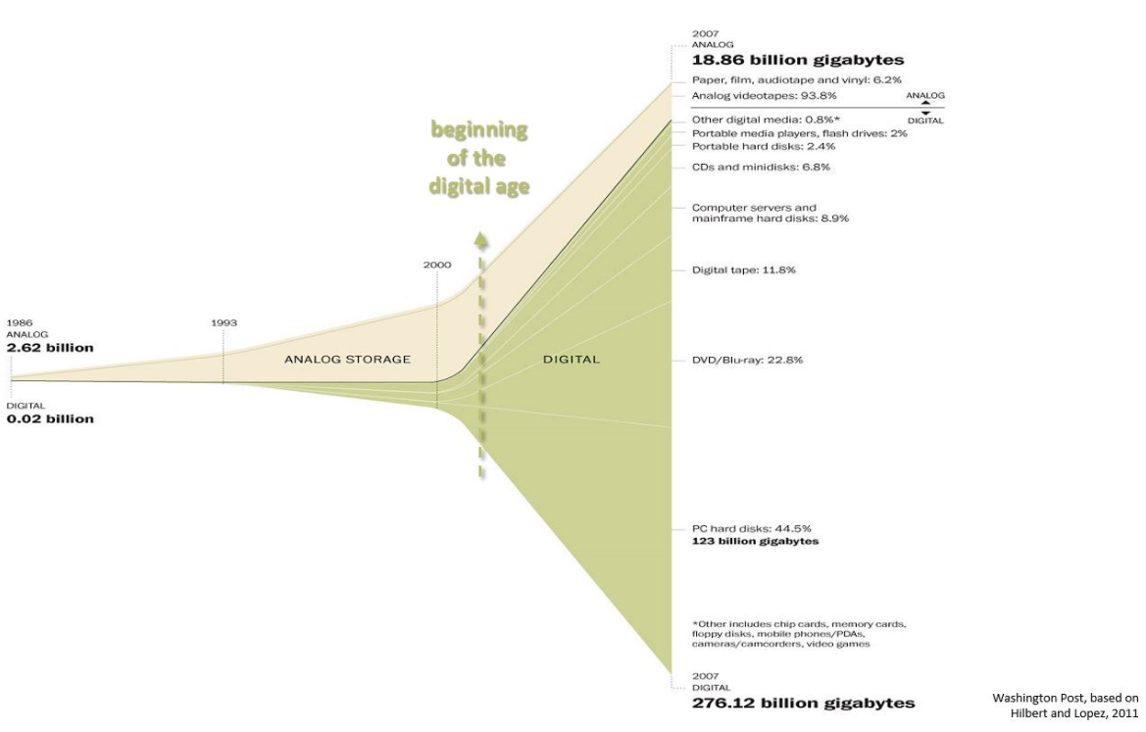
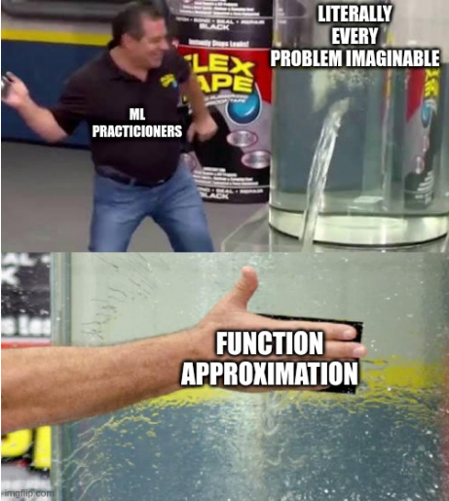
ML a.k.a. function approximation from data
Put simply, if we can’t express the function that maps a problem to the desired solution analytically, then perhaps we can learn the function by example, i.e. from data.
► This is most similar to how we learn as humans (e.g., learning to recognise faces)

Slide 7
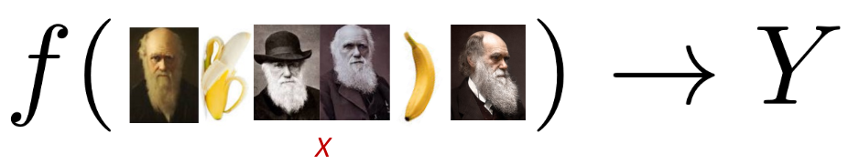
Unsupervised Learning
Given a dataset X without any knowledge of labels (outputs), we are looking for interesting patterns / structure.
TO-BE-LEARNED MAPPING FUNCTION
UNLABELED DATA
PATTERNS / STRUCTURE

Slide 8

Limitations: Curse of dimensionality
Assume that our input X consists of relatively small images, 640x480
Say we represent our data (features) with pixel intensities (i.e. grayscale)
  640 x 480 ~ 300 000 floating point values (4-8 bytes each)
If images are RGB
  640 x 480 x 3 ~ 1M
This is called the dimensionality of the data:
  Formally, this corresponds to the number of random variables
  Informally: the number of dimensions
    Here: each pixel can correspond to a dimension of our data X
    Each image in our data, X, has a value for each dimension
    Visualization / exploratory data analysis

Slide 9
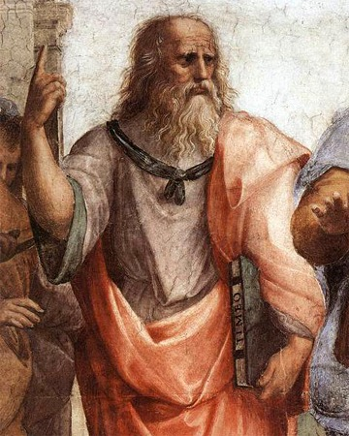
Philosophical intermezzo
Plato: ancient Greek philosopher of the 4th century
Key concept: Forms
Everything in this world is a “shadow” of its Ideal Form, existing only in the world of ideas.
E.g. images of horses we experience through our senses (in this case, vision) are all imperfect examples of the archetypal idea of a horse.
This ideal essence of a horse (let’s say “horse-ness”) is present in each of these imperfect examples.
Can we “reveal” elements of this essence and, if yes, how?

Slide 10
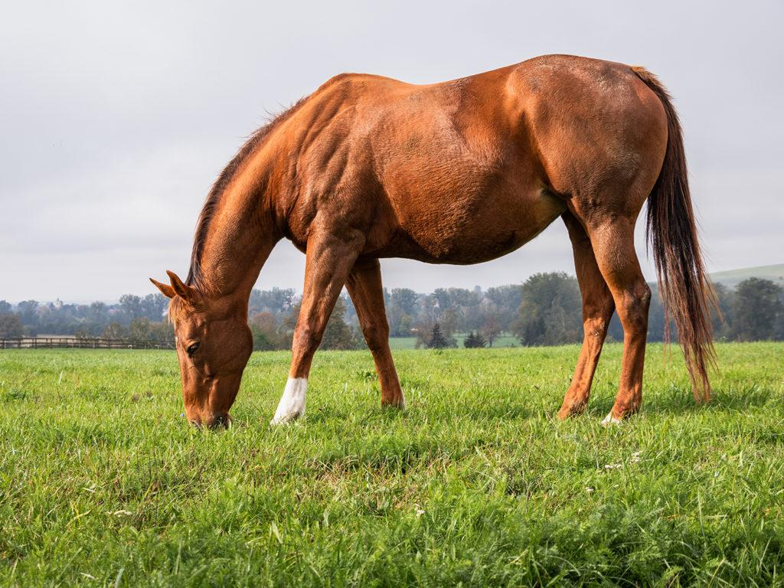

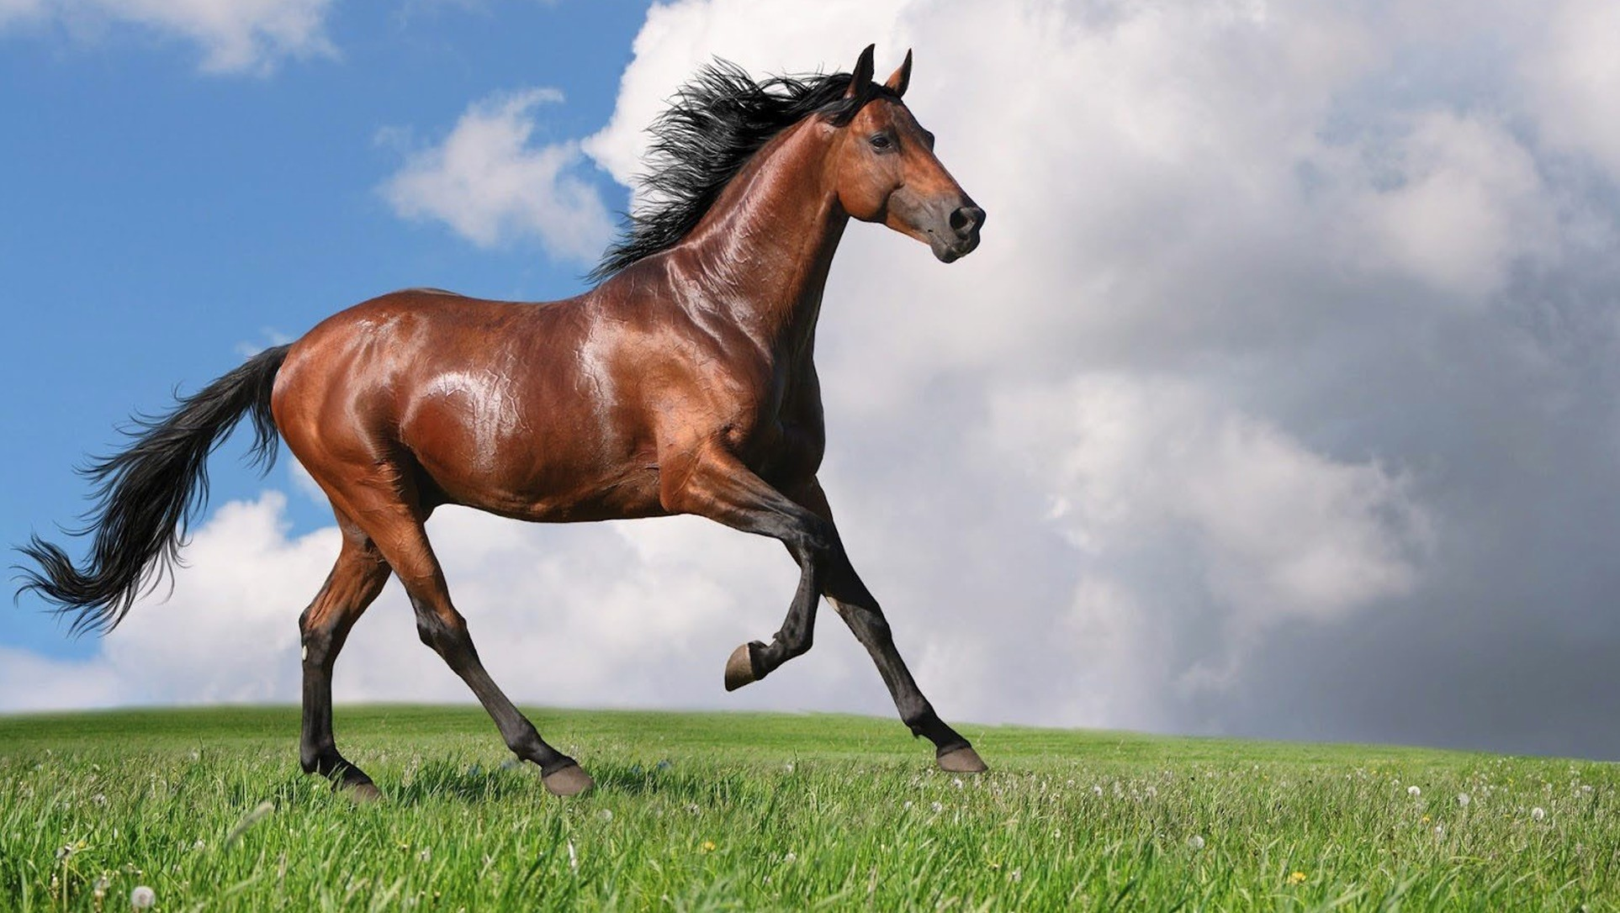
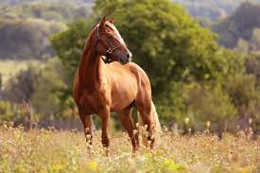
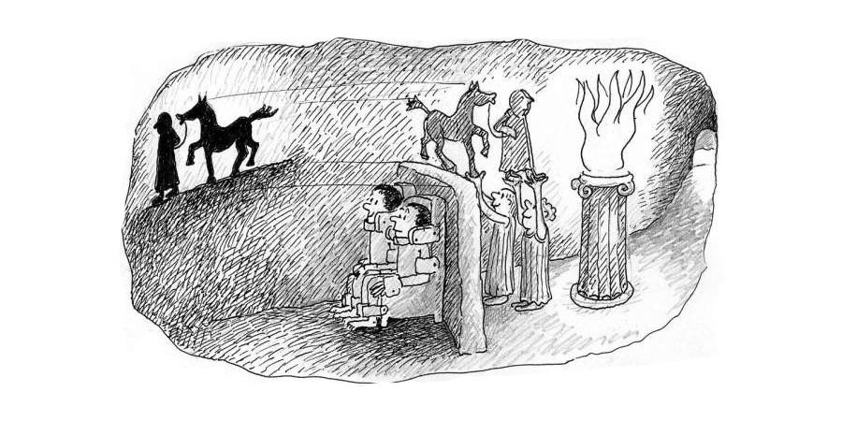
Philosophical intermezzo
The underlying reality
Sensual experience
…

Slide 11
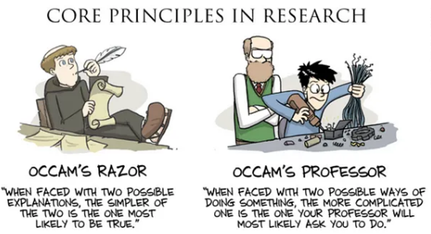
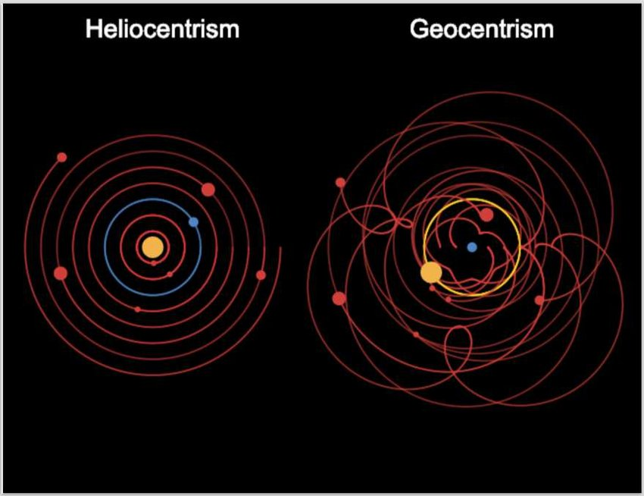
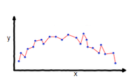
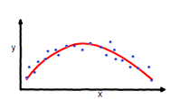
Philosophical intermezzo
Function modeled very complex
(more particular than it should be)
Function modeled is of balanced complexity
(fits the data adequately)

Slide 12
Back to Unsupervised Learning: Dimensionality Reduction
Assume that our input X consists of relatively small images, 640x480
Say we represent our data (features) with pixel intensities (i.e. grayscale)
  640 x 480 ~ 300 000 floating point values (4-8 bytes each)
If images are RGB
  640 x 480 x 3 ~ 1M
Goal: Reduce the dimensionality of our data – compress the observations and discover latent underlying factors
  Learn a function mapping to a lower-dimensional space
Motivation: Although data may appear high-dimensional, their essence can be often summarized by using a low-dimensional representation
This representation consists of latent factors that are not directly observed in the data

Slide 13
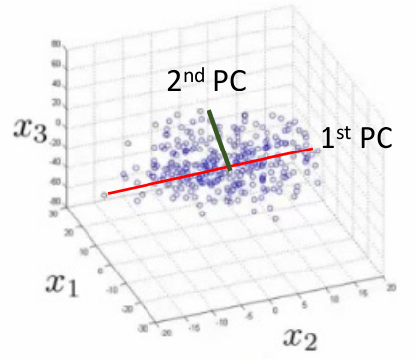
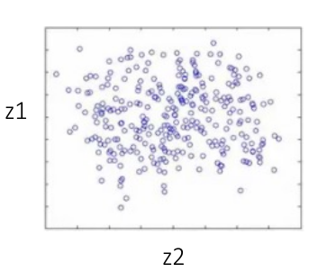
Intro to Principal Component Analysis
Goal: Reduce dimensionality, while preserving data variability
  Project onto the principal axis of variation
Project onto 1st and 2nd PCs to reduce dimensionality
Information loss post-projection minimal when compared to the gains in terms of complexity
Principal components capture the variance of the data in descending importance

Slide 14
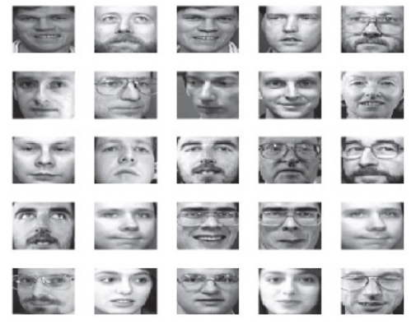
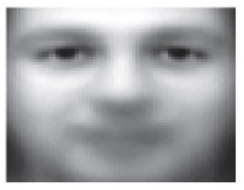
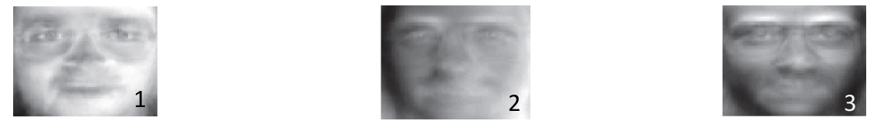
Discovering Latent Factors: Faces
Modelling face image appearance:
Variability: lighting, pose, identity,…
Mean human face
(latent, lower-dimensional representation)
Principal Components (directions) describe deviation of images from mean

Slide 15
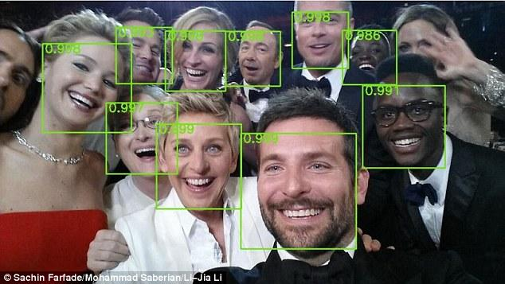
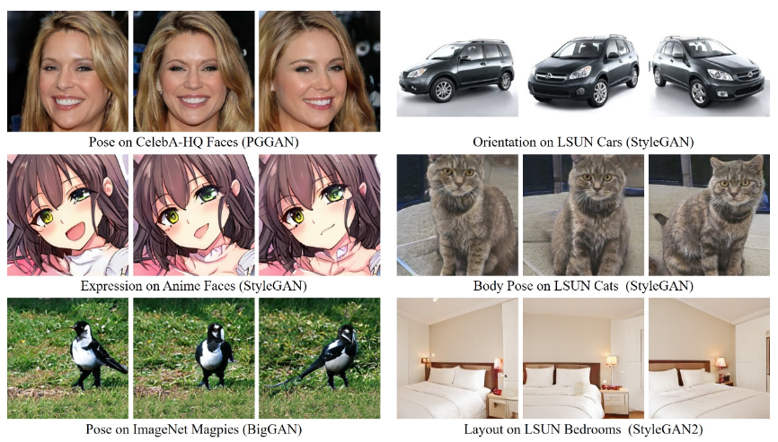
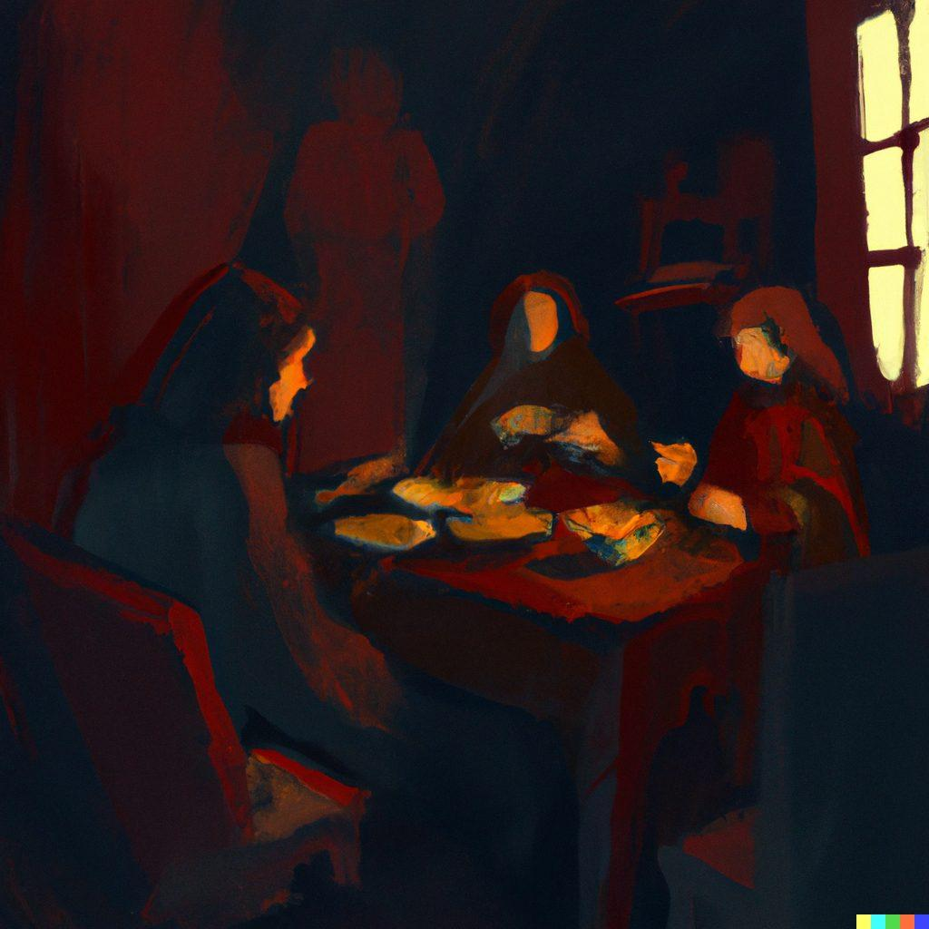
Why exposing the underlying variability matters?
Just by pure observation we can:
Prompt: Eerie painting of a feast in a dimly lit room, using shadows and low-light techniques.
Capture the essence of a “human face” and then detect it ad hoc in any pic
Infer text-vision relationships and proceed to aid human creativity by prompt engineering
Discover the underlying semantics and edit them at will

Slide 16
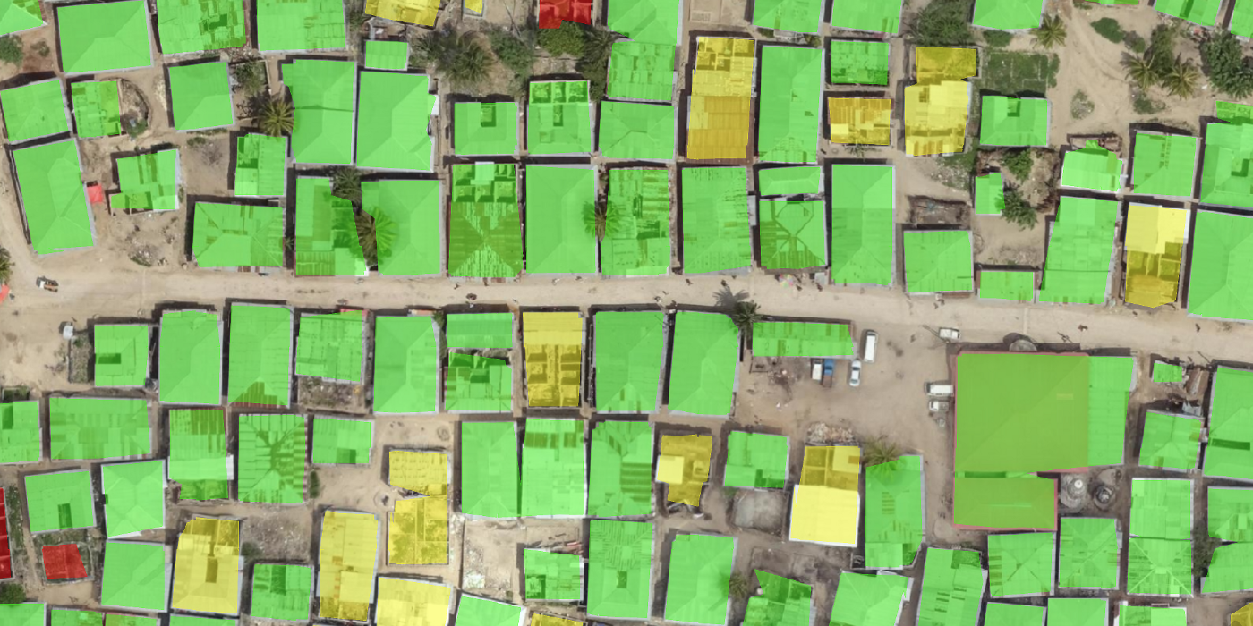
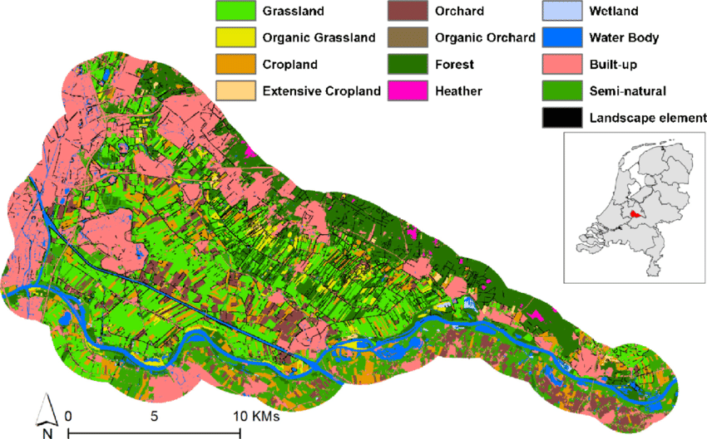
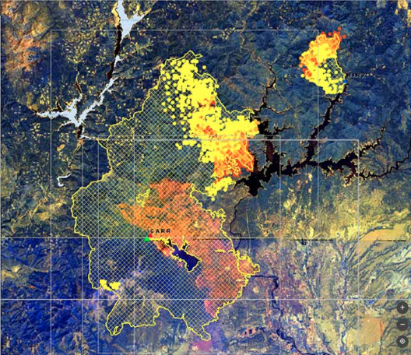
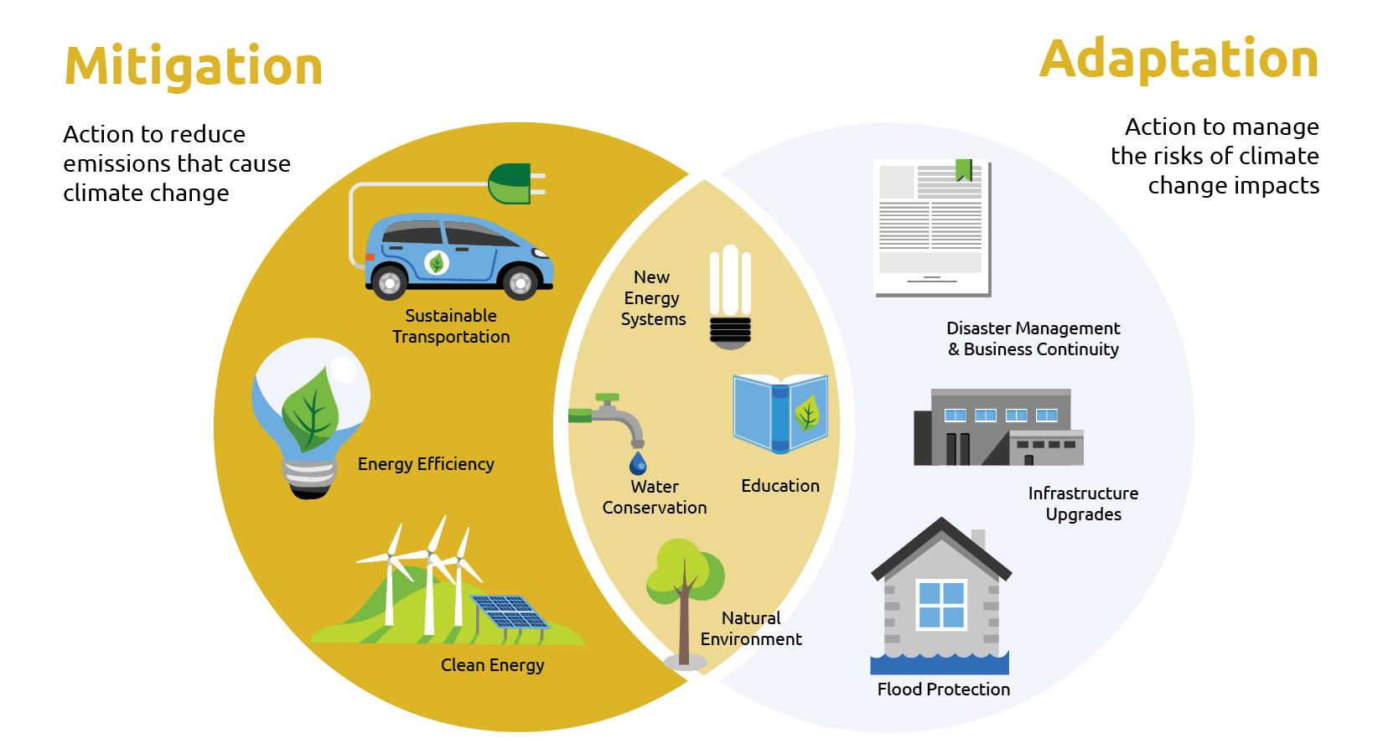
But what about Satellite Images?
Remote Sensing: acquisition of information about an object or phenomenon without making physical contact with the object, usually via satellites.
Rapid progress: methods + data.
Impactful applications:
Remote Sensing: acquisition of information about an object or phenomenon without making physical contact with the object, usually via satellites.
Rapid progress: methods + data.
Impactful applications:
Natural candidate for ML!
urban monitoring
land-use mapping
risk assessment and
prevention
climate mitigation and adaptation

Slide 17

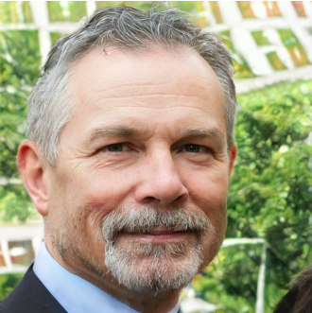
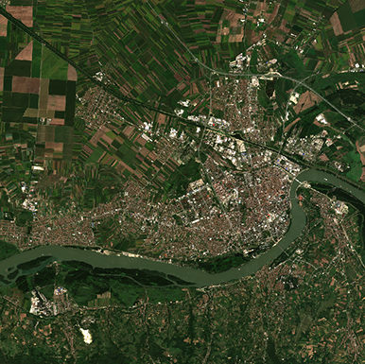
AI for Satellite Imagery
Characteristics of SI (satellite imagery) data:
Great spatial and spectral variability (ground distance, structures scale, spectral signatures)
Wide presence of fine, high-frequency details
Tedious annotations → label scarcity, data delusion (not enough variability in datasets)
However, typical
Computer Vision datasets:
Well-aligned
Annotated
Limited variability
Use of models tailored for typical CV tasks not straightforward!!!
VS.

Slide 18
Challenges in AI for Satellite Imagery
Typical SI + ML problems (e.g. remote scene classification, building segmentation) tend to rely on quality annotations → Challenge #3
Possible solutions:
  Leverage pre-trained models for standard vision tasks (real-world imagery) → Challenge #1, 2
  Use baseline GAN models to bridge data acquisition gap by employing them as data augmentation modules → Challenge #1, 2
  Gap to be filled: train a GAN model that can efficiently tackle #1 and #2 while being able to provide alternatives for #3.

Slide 19
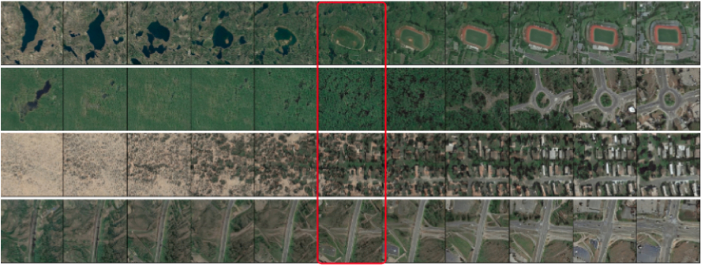



Unsupervised Discovery of Semantic Concepts in Satellite Imagery with Style-based Wavelet-driven Generative Models
Nikos Kostagiolas¹, Mihalis A. Nicolaou¹, Yannis Panagakis²
¹ The Cyprus Institute
² National and Kapodistrian University of Athens
Link to Github
Nikos Kostagiolas, Mihalis A. Nicolaou, Yannis Panagakis

Slide 20
Contributions
First pre-trained style-based GAN for satellite image (SI) generation
  style-based architectures → sense of hierarchy, synthetic results of great diversity (Challenges #1 + 2)
  SWAGAN: style-based architecture, augmented with wavelet-based features → spectral information (Challenge #1)
Meaningful directions discovery
  High-level concepts such as urbanization.
  Opens the way for controllable image synthesis (Challenge #3)
Qualitative + quantitative analysis
  Demonstrate suitability of synthetic results for use in downstream tasks (e.g. data augmentation) even on unseen datasets (Challenge #3)

Slide 21
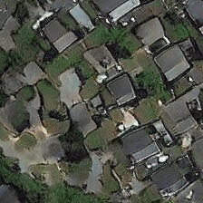
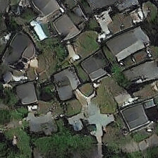
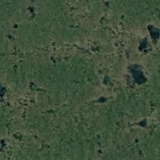
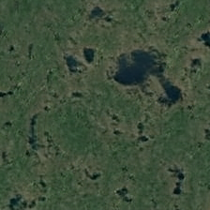
Summary of pipeline
controllable synthesis
(class label same despite minor context alteration)
authentic + diverse generations
quantitative analysis
(proof of concept)
Downstream tasks (e.g. data augmentation)

Slide 22
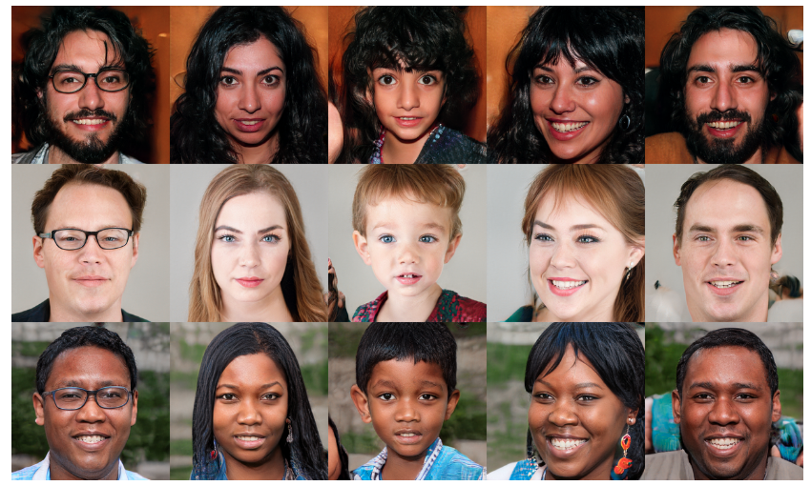
Goal #1: Towards high-fidelity SI generation: style-based GANs
Style-based generators treat each image as a collection of “styles”, thus representing them in a hierarchical manner.
Each of those styles regulates a specific property of that image.
Styles range from coarse ones (e.g. pose, gender, etc.) to finer ones (e.g. facial features, skin colour, etc.).
Source: https://github.com/NVlabs/stylegan

Slide 23
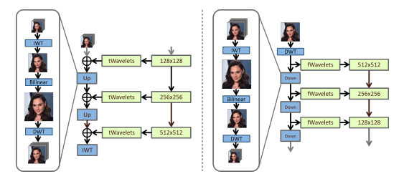
Realistic + Diverse SI Generation: The SWAGAN model
SI: rich in spectral information which StyleGAN has no capabilities of harnessing.
SWAGAN: complements Style-based architectures with spectral information by introducing a series of wavelet decompositions in the layers of StyleGAN.
Source: A style-based wavelet-driven generative model [6]

Slide 24
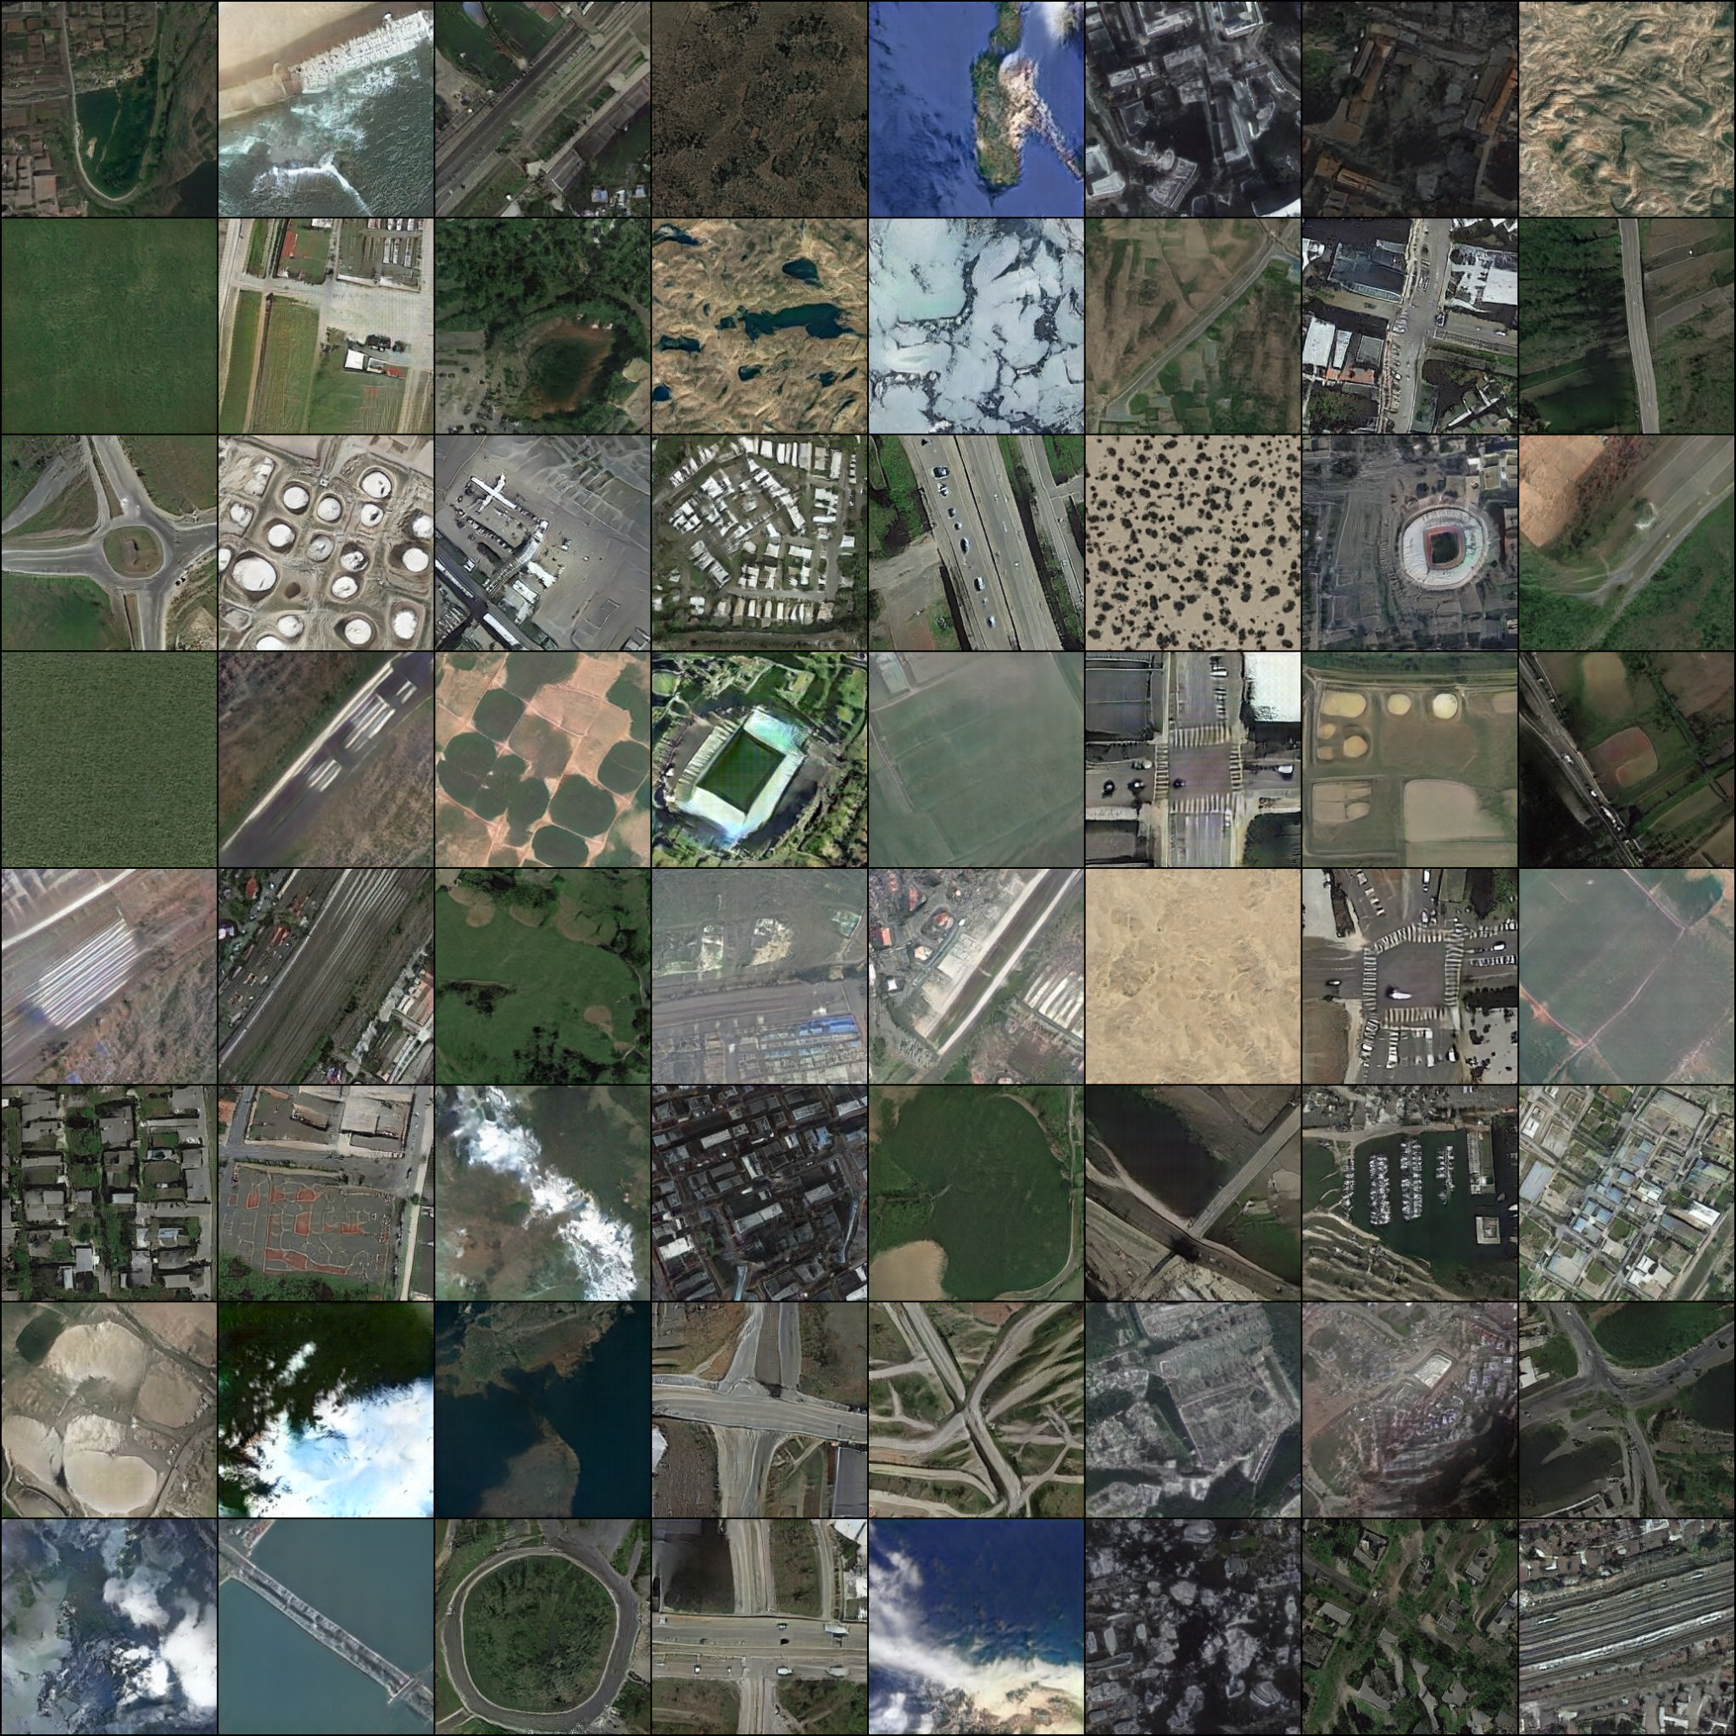
Realistic + Diverse SI Generation: Results

Slide 25
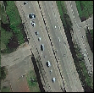
Realistic + Diverse SI Generation: Results

Slide 26
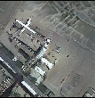
Realistic + Diverse SI Generation: Results

Slide 27
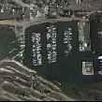
Realistic + Diverse SI Generation: Results

Slide 28
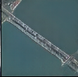
Realistic + Diverse SI Generation: Results

Slide 29
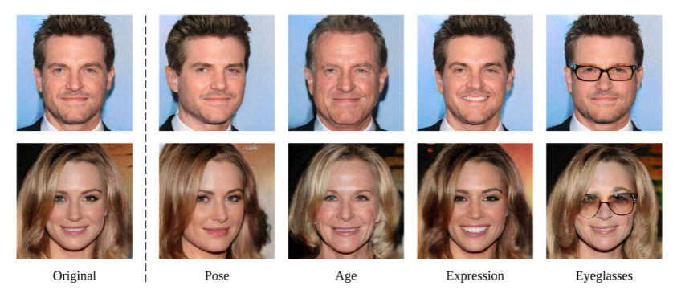
Goal #2: Controllable synthesis of satellite imagery
Question: Can we use our pre-trained SI synthesis model to address annotation scarcity and diversity issues?
Example (facial models): well-trained + linear transformations→ precise control of attributes.
Source: Interpreting the latent space of gans for semantic face editing [4]

Slide 30


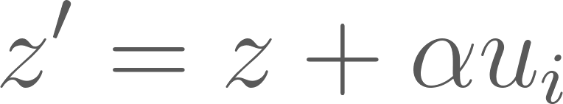

Goal #2: Controllable synthesis of satellite imagery
How*:
Apply Principal Component Analysis (PCA) on the weight matrix A of a projection layer of the generative model → discover directions that lead to large variation in the output.
Directions correspond to top-k eigenvectors of the covariance matrix of weights, .
Perform an edit by manipulating latent code z towards by , where is the edit magnitude → Pass through G for edited image.
Idea: Find meaningful directions that, via context-based alterations of the original image, will efficiently provide with quality data.
*: More info regarding approach: Closed-Form Factorization of Latent Semantics in GANs[5]

Slide 31
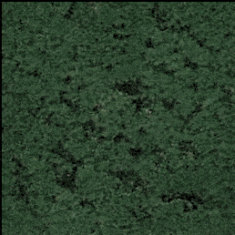
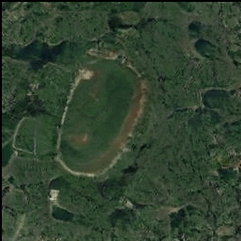
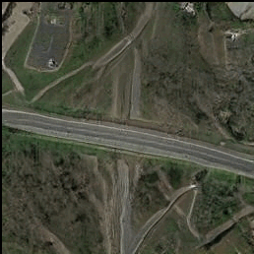
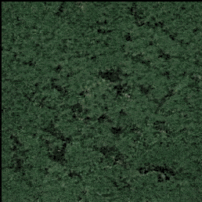
Goal #2: Identifying meaningful directions - Urbanization
Post-edit: Urbanization growth
Post-edit: Urbanization diminishment

Slide 32


Goal #2: Identifying meaningful directions - Structure addition/removal based on axis of orientation
Moving towards direction: horizontal structure (i.e. road) removal
Moving away from direction: horizontal structure (i.e. road) definition
vs.
Moving towards direction: vertical structure (i.e. stadium) definition
Moving away from direction: vertical structure (i.e. road) removal

Slide 33


Goal #2: Identifying meaningful directions - Primary/secondary structure definition
Moving towards direction: main structure (i.e. road) definition
Moving away from direction: secondary structure (i.e. chaparral) definition
vs.
Moving towards direction: main structure (i.e. water) definition
Moving away from direction: secondary structure (i.e. ice) definition

Slide 34


Goal #2: Identifying meaningful directions - Road structure addition/removal
Moving towards direction: road structure gets defined
Moving away from direction: road structure is removed
vs.
Moving towards direction: road introduction to otherwise barren wetland
Moving away from direction: no roads added

Slide 35


Goal #2: Identifying meaningful directions - Flora definition/pruning
Moving towards direction: flora diminished (road remains)
Moving away from direction: flora enhanced
(road remains)
vs.
Moving towards direction: water land mass (no flora)
Moving away from direction: water land mass (flora)

Slide 36
Goal #3: Suitability of generations for downstream tasks
Train a remote scene classifier (ResNet-50) on three distinct, artificially imbalanced datasets (RESISC-45, AID, UC-Merced).
Employ our SWAGAN model, trained solely on RESISC-45 for data augmentation to re-introduce balance.
Compare the resulting performance against a baseline data augmentation approach, relying on a set of affine transformations such as rotations and translations.
Motivation: geometrical variation (baseline) vs. concept-based variation (ours)

Slide 37







Goal #3: Example synthetic images for data augmentation
Uncurated synthetic examples employed for data augmentation with their corresponding annotations:
desert
medium
residential
lake
freeway
meadow
wetland
forest

Slide 38

Goal #3: Results

Slide 39
Goal #3: Results - Comparing variability introduction
concept-based (ours) > geometry-based (baseline) variability

Slide 40
Goal #3: Results - Generalization
Generalization capabilities evident, even on unseen datasets (AID, UC-Merced)

Slide 41
Goal #3: Results - Synergy
Increased performance when both concept-based and baseline, affine-transformation based augmentation are employed

Slide 42
Locality-preserving Directions for Interpreting the Latent Space of Satellite Image GANs
Georgia Kourmouli*, Nikos Kostagiolas*, Yannis Panagakis, Mihalis A. Nicolaou
(*author contributed equally to this work)
Nikos Kostagiolas, Mihalis A. Nicolaou, Yannis Panagakis
(accepted for publication at the IEEE Geoscience and Remote Sensing Letters)

Slide 43
Bringing locality into play
Semantic concept discovery up to this work: relies on global, PCA-like methods → variance maximization-only criteria
What if we could regularize the dim. reduction process by also seeking to preserve locality?
  Question #1: Can locality-preservation benefit our pre-trained model generations diversity?
  Question #2: Can locality-aware methods outperform PCA-based ones when leveraged in data augmentation?

Slide 44
This Work
First locality-aware approach for interpreting the latent space of frequency-based SI GANs.
Qualitatively establish the method’s efficacy in terms of diversity of generations
Highlight why preserving local structure matters, via quantitative experiments
Demonstrate that locality-based augmented samples may also complement traditional geometric-based augmentation strategies

Slide 45
Locality Preserving Projections [8]
Linear approach to preserving local structure of the GAN latent space.
Common ground w/ PCA-based approaches: assumes generator weight space lies on a low-dim. manifold.
Difference: instead of working on covariant matrix of W, use the adjacency graph of it.
How?
  Construct adjacency by applying kNN on generator weight vectors:
  Construct W by assigning when vectors i and j are neighboring, otherwise:

Slide 46

Locality Preserving Projections (cont.)
Optimal locality-preserving mapping criterion:
(2)
Where A is the weight matrix, D is diagonal degree matrix of W and L = D - W is the Laplacian.
In our case:
  k = 10

Slide 47

Performing edits & Overall Pipeline
Top-7 eigenvectors from (2) represent most significant latent space directions (similar to previous work).
Edit latents using:
Overall pipeline:

Slide 48

Editing Observations
Directions found via LPP semantically correspond to similar changes in PCA.
However: Quantitative evidence of difference between locality-based directions and their PCA-based counterparts do exist (angle deviation):

Slide 49
Editing Observations (cont.)
Qualitative evidence of difference between the locality-based and PCA-based directions (edit magnitude = 1.0):
locality-based
pca-based
locality-based
pca-based

Slide 50
Editing Observations (cont.)
Qualitative evidence of difference between the locality-based and PCA-based directions (edit magnitude = 3.0):
locality-based
pca-based
locality-based
pca-based

Slide 51
Key takeaways
Locality-based approach prevails both in terms of quality and class preservation
  Shapes and class information maintained independently of edit magnitude.
PCA-based approach:
  Fails to preserve class information even when small edit magnitudes are used.
  Creates artifacts in the extreme case.

Slide 52

Quantitative Evaluation: Experiment I
Use identical augmentation configuration as in previous paper.
Dismiss samples that were classified with < 0.8 certainty.
Strong evidence that locality preservation promotes diversity.
Experiments w/ lower thresholds broaden the gap between the two methods (LPP-based maintains class info better)

Slide 53

Quantitative Evaluation: Mixed methods
What if we opt to leverage both baseline, geometry-based info with any of the two methods?
Strong evidence that locality-based approach works jointly better with geometric approaches.

Slide 54

Quantitative Evaluation: Experiments III and IV
Aforementioned experiments
  Mixed methods: increase training size by 9 vs. Baseline: increases training size by 5.
  What if we use same size for all data augmentation methods (including baseline)?
  Pure data aug. strategies are comparable in this setting (ceiling in terms of variability - saturation)
  Mixed methods still prevail (geometric and context-based work in conjunction)

Slide 55

Quantitative Evaluation: Experiment V
Which method is better at preserving class info?
Strategy: Classify only G(z), then use predicted label to classify further augmentations using the same latent code.
Locality-based method outperforms (increased variability + class maintenance)

Slide 56

What’s next?
Foundation Models, a recap: trained on Internet-scale image-text datasets to generate high-resolution images from user-provided captions.
  In essence, these models learn the joint distribution p(x,y) where x: images, y: text.
  Language predates logic → models such as these are equipped with the ability to reason about everything they have modeled
  Examples: ChatGPT, BERT, DALL-E, etc.
Image generated by DALL·E 3 with GPT-4 based on the text prompt "A modern architectural building with large glass windows, situated on a cliff overlooking a serene ocean at sunset."

Slide 57


Towards a climate-aware FM for Satellite Images
Question: Can we train a Foundation Model that learns p(x,y) where x: environmental metadata and y: satellite images?
Possible applications: Given novel environmental metadata and a reference image, predict the new image or vice-versa
e.g.
prompt: < (lat,lon), time, temperature, wind conditions, cloud presence, humidity, precipitation, … >

Slide 58
Questions
What is the minimum number of environmental parameters that are essential for efficient and accurate predictions?
  ERA5 dataset:
    Documents hourly environmental observations since 1940 and ongoing as we speak
    > 200 different parameters
    Most of the data are stored in magnetic disks (!!!) and, depending on the number of requested parameters, it may take months to become available
Does any form of aggregation need to be applied?
  E.g. the lawn outside my house is green, but this fact doesn’t necessarily rely on the current environmental conditions.
  In other words, heavy rain during the previous days may be equally, if not more, important.
Do population data need to be included?
  E.g. population density data may be key for the model to adequately predict urbanization, especially in cases where long-term predictions are targeted.

Slide 59

Thank you!

