Slide 1
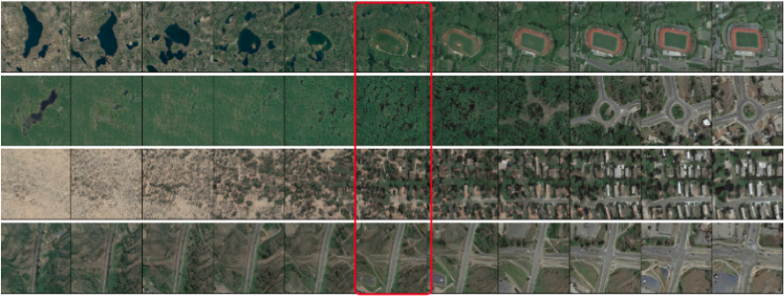
Unsupervised Discovery of Semantic Concepts in Satellite Imagery with Style-based Wavelet-driven Generative Models
Nikos Kostagiolas¹, Mihalis A. Nicolaou¹, Yannis Panagakis²
¹ The Cyprus Institute
² National and Kapodistrian University of Athens
Link to Github
Nikos Kostagiolas, Mihalis A. Nicolaou, Yannis Panagakis

Slide 2
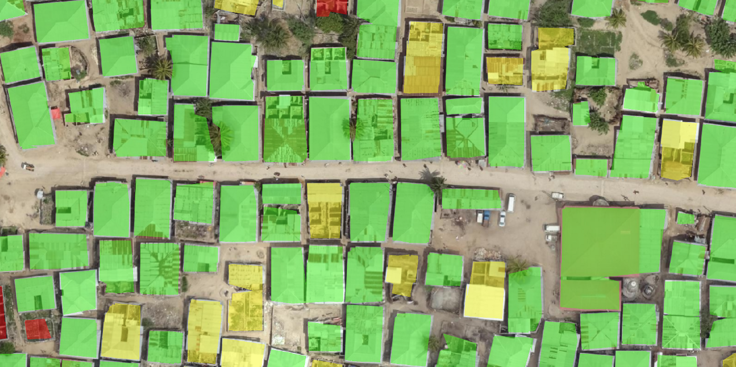
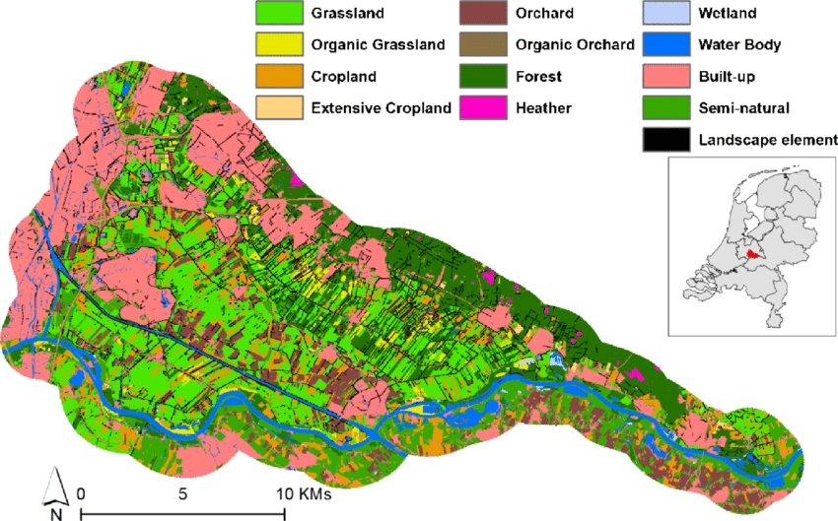
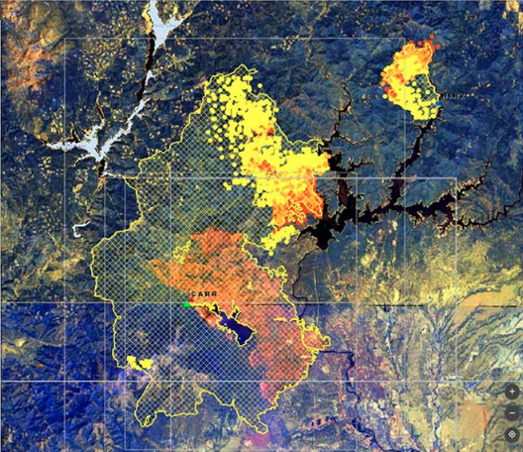
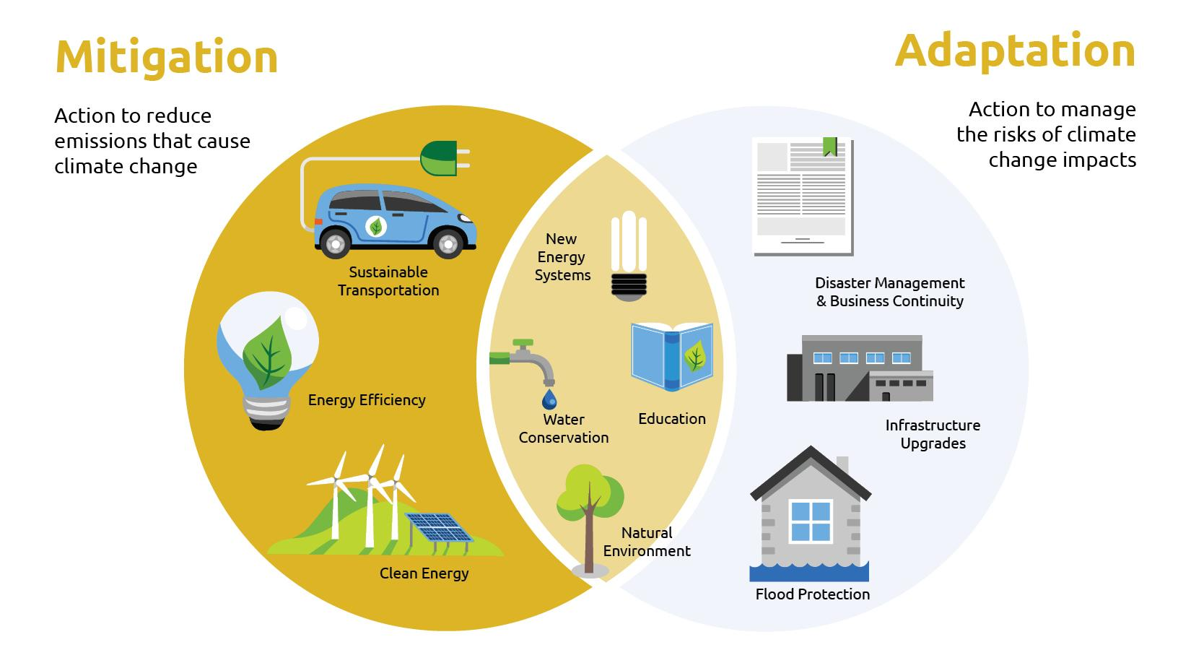
Geospatial AI: Motivation
Remote Sensing: acquisition of information about an object or phenomenon without making physical contact with the object, usually via satellites.
Rapid progress: methods + data.
Impactful applications:
Remote Sensing: acquisition of information about an object or phenomenon without making physical contact with the object, usually via satellites.
Rapid progress: methods + data.
Impactful applications:
Natural candidate for ML!
urban monitoring
land-use mapping
risk assessment and
prevention
climate mitigation and adaptation

Slide 3
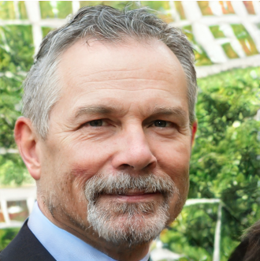
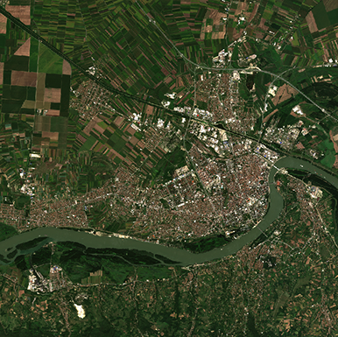
AI for Satellite Imagery
Characteristics of SI (satellite imagery) data:
Great spatial and spectral variability (ground distance, structures scale, spectral signatures)
Wide presence of fine, high-frequency details
Tedious annotations → label scarcity, data delusion (not enough variability in datasets)
However, typical
Computer Vision datasets:
Well-aligned
Annotated
Limited variability
Use of models tailored for typical CV tasks not straightforward!!!
VS.

Slide 4
Challenges in AI for Satellite Imagery
Typical SI + ML problems (e.g. remote scene classification, building segmentation) tend to rely on quality annotations → Challenge #3
Possible solutions:
Leverage pre-trained models for standard vision tasks (real-world imagery) → Challenge #1, 2
Use baseline GAN models to bridge data acquisition gap by employing them as data augmentation modules → Challenge #1, 2
Gap we want to fill: train a GAN model that can efficiently tackle #1 and #2 while being able to provide alternatives for #3.

Slide 5
Contributions
First pre-trained style-based GAN for satellite image (SI) generation
style-based architectures → sense of hierarchy, synthetic results of great diversity (Challenges #1 + 2)
SWAGAN: style-based architecture, augmented with wavelet-based features → spectral information (Challenge #1)
Meaningful directions discovery
High-level concepts such as urbanization.
Opens the way for controllable image synthesis (Challenge #3)
Qualitative + quantitative analysis
Demonstrate suitability of synthetic results for use in downstream tasks (e.g. data augmentation) even on unseen datasets (Challenge #3)

Slide 6
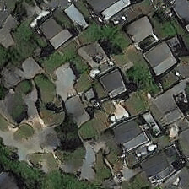
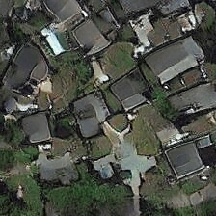
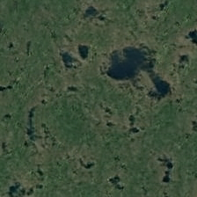
Summary of pipeline
controllable synthesis
(class label same despite minor context alteration)
authentic + diverse generations
quantitative analysis
(proof of concept)
Downstream tasks (e.g. data augmentation)

Slide 7
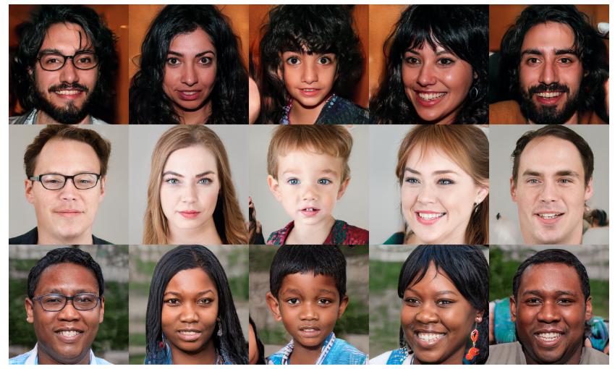
Goal #1: Towards high-fidelity SI generation: style-based GANs
Style-based generators treat each image as a collection of “styles”, thus representing them in a hierarchical manner.
Each of those styles regulates a specific property of that image.
Styles range from coarse ones (e.g. pose, gender, etc.) to finer ones (e.g. facial features, skin colour, etc.).
Source: https://github.com/NVlabs/stylegan

Slide 8
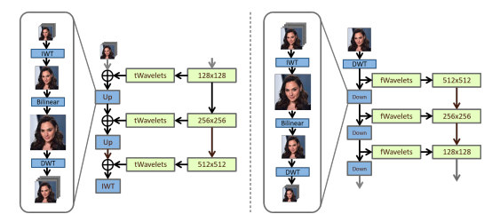
Realistic + Diverse SI Generation: The SWAGAN model
SI: rich in spectral information which StyleGAN has no capabilities of harnessing.
SWAGAN: complements Style-based architectures with spectral information by introducing a series of wavelet decompositions in the layers of StyleGAN.
Source: A style-based wavelet-driven generative model [6]

Slide 9
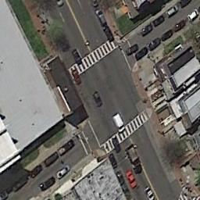
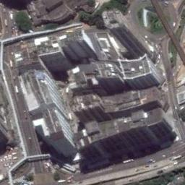
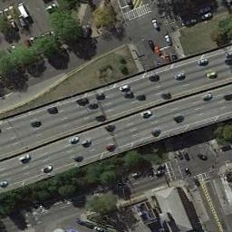
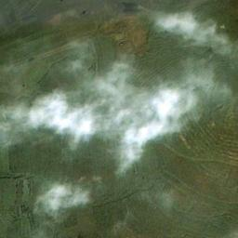
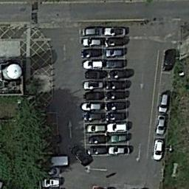
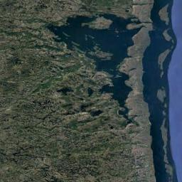
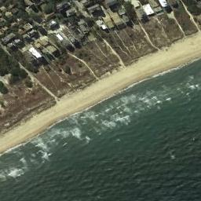
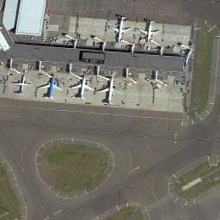
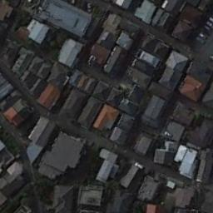
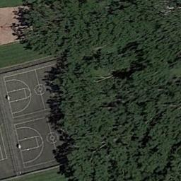
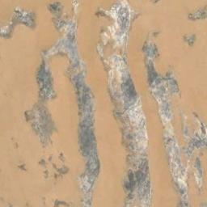
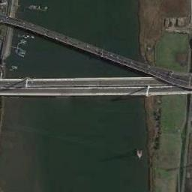
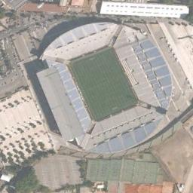
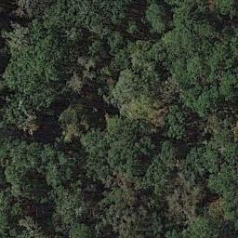
Realistic + Diverse SI Generation: The RESISC-45 dataset
Dataset used for our model training: RESISC-45.
RESISC-45: 31,500 optical satellite images of 256 x 256 resolution, covering 45 scene classes with 700 images in each class.
Source: RESISC-45 dataset

Slide 10
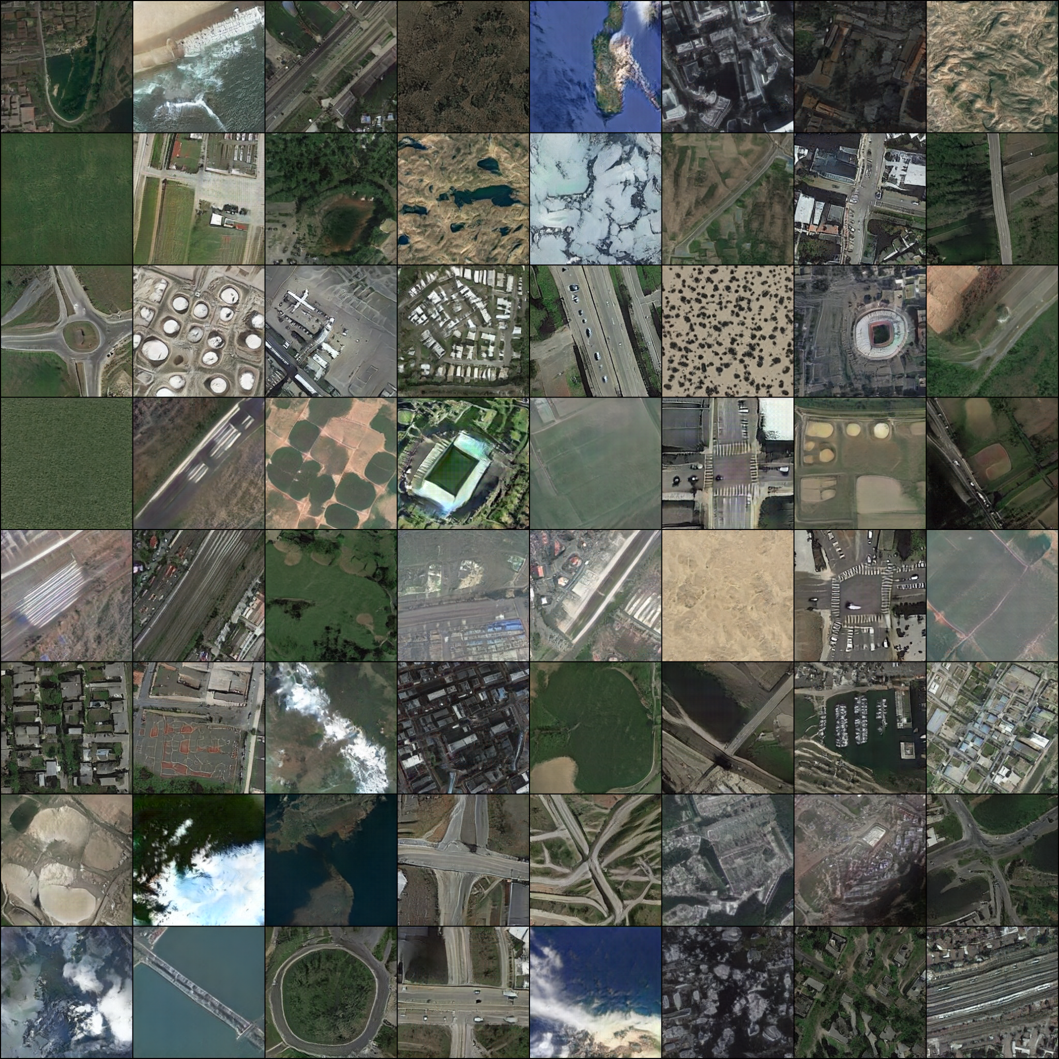
Realistic + Diverse SI Generation: Results

Slide 11
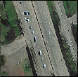
Realistic + Diverse SI Generation: Results

Slide 12
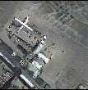
Realistic + Diverse SI Generation: Results

Slide 13
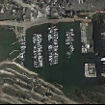
Realistic + Diverse SI Generation: Results

Slide 14
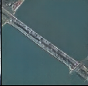
Realistic + Diverse SI Generation: Results

Slide 15
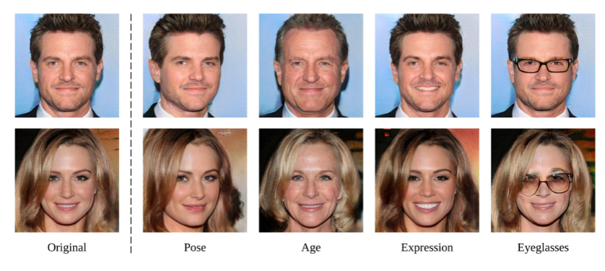
Goal #2: Controllable synthesis of satellite imagery
Question: Can we use our pre-trained SI synthesis model to address annotation scarcity and diversity issues?
Example (facial models): well-trained + linear transformations→ precise control of attributes.
Source: Interpreting the latent space of gans for semantic face editing [4]

Slide 16
Goal #2: Controllable synthesis of satellite imagery
How*:
Apply Principal Component Analysis (PCA) on the weight matrix A of a projection layer of the generative model → discover directions that lead to large variation in the output.
Directions correspond to top-k eigenvectors of the covariance matrix of weights, .
Perform an edit by manipulating latent code z towards by , where is the edit magnitude → Pass through G for edited image.
Idea: Find meaningful directions that, via context-based alterations of the original image, will efficiently provide with quality data.
*: More info regarding approach: Closed-Form Factorization of Latent Semantics in GANs[5]

Slide 17
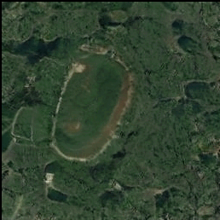
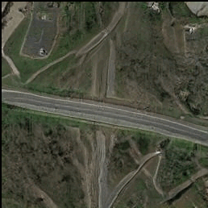
Goal #2: Identifying meaningful directions - Urbanization
Post-edit: Urbanization growth
Post-edit: Urbanization diminishment

Slide 18
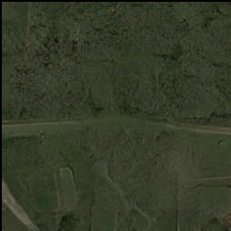
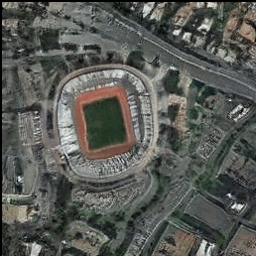
Goal #2: Identifying meaningful directions - Structure addition/removal based on axis of orientation
Moving towards direction: horizontal structure (i.e. road) removal
Moving away from direction: horizontal structure (i.e. road) definition
vs.
Moving towards direction: vertical structure (i.e. stadium) definition
Moving away from direction: vertical structure (i.e. road) removal

Slide 19
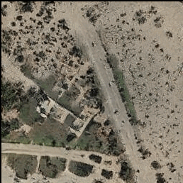
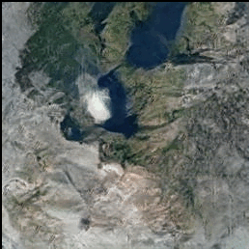
Goal #2: Identifying meaningful directions - Primary/secondary structure definition
Moving towards direction: main structure (i.e. road) definition
Moving away from direction: secondary structure (i.e. chaparral) definition
vs.
Moving towards direction: main structure (i.e. water) definition
Moving away from direction: secondary structure (i.e. ice) definition

Slide 20
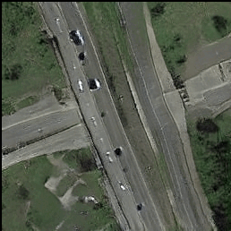
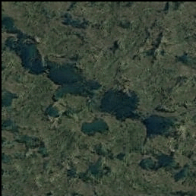
Goal #2: Identifying meaningful directions - Road structure addition/removal
Moving towards direction: road structure gets defined
Moving away from direction: road structure is removed
vs.
Moving towards direction: road introduction to otherwise barren wetland
Moving away from direction: no roads added

Slide 21
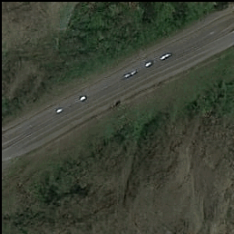
Goal #2: Identifying meaningful directions - Flora definition/pruning
Moving towards direction: flora diminished (road remains)
Moving away from direction: flora enhanced
(road remains)
vs.
Moving towards direction: water land mass (no flora)
Moving away from direction: water land mass (flora)

Slide 22
Goal #3: Suitability of generations for downstream tasks
Train a remote scene classifier (ResNet-50) on three distinct, artificially imbalanced datasets (RESISC-45, AID, UC-Merced).
Employ our SWAGAN model, trained solely on RESISC-45 for data augmentation to re-introduce balance.
Compare the resulting performance against a baseline data augmentation approach, relying on a set of affine transformations such as rotations and translations.
Motivation: geometrical variation (baseline) vs. concept-based variation (ours)

Slide 23
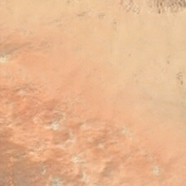
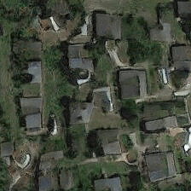
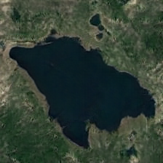
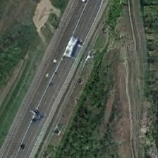
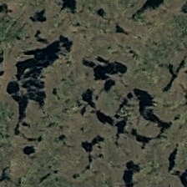
Goal #3: Example synthetic images for data augmentation
Uncurated synthetic examples employed for data augmentation with their corresponding annotations:
desert
medium
residential
lake
freeway
meadow
wetland
forest

Slide 24
Goal #3: Results

Slide 25
Goal #3: Results - Comparing variability introduction
concept-based (ours) > geometry-based (baseline) variability

Slide 26
Goal #3: Results - Generalization
Generalization capabilities evident, even on unseen datasets (AID, UC-Merced)

Slide 27
Goal #3: Results - Synergy
Increased performance when both concept-based and baseline, affine-transformation based augmentation are employed

Slide 28
Summary - Key takeaways
First pre-trained style-based GAN for satellite image generation.

Slide 29
Summary - Key takeaways
First pre-trained style-based GAN for satellite image generation.
Wavelet-driven GANs → Well-capture SI intricacies.

Slide 30
Summary - Key takeaways
First pre-trained style-based GAN for satellite image generation.
Wavelet-driven GANs → Well-capture SI intricacies.
Latent space exploration → Semantic concept control (urbanization, vegetation growth, wetland density, etc.).

Slide 31
Summary - Key takeaways
First pre-trained style-based GAN for satellite image generation.
Wavelet-driven GANs → Well-capture SI intricacies.
Latent space exploration → Semantic concept control (urbanization, vegetation growth, wetland density, etc.).
High-fidelity + diverse synthetic imagery → ad-hoc use for downstream tasks (e.g. data augmentation) + cross-dataset adaptation.

Slide 32
Thank you!

Slide 33
References
[1] Tero Karras, Samuli Laine, Miika Aittala, Janne Hellsten, Jaakko Lehtinen, and Timo Aila. Analyzing and improving the image quality of stylegan. In Proceedings of the IEEE/CVF Conference on Computer Vision and Pattern Recognition, pages 8110–8119, 2020.
[2] Alec Radford, Luke Metz, and Soumith Chintala. Unsupervised representation learning with deep convolutional generative adversarial networks. In ICLR, 2016.
[3] David Bau, Jun-Yan Zhu, Hendrik Strobelt, Bolei Zhou, Joshua B. Tenenbaum, William T. Freeman, and Antonio Torralba. Visualizing and understanding generative adversarial networks. In ICLR, 2019
[4] Yujun Shen, Jinjin Gu, Xiaoou Tang, and Bolei Zhou. Interpreting the latent space of gans for semantic face editing. In IEEE Conf. Comput. Vis. Pattern Recog., 2020.

Slide 34
References
[5] Y. Shen and B. Zhou. Closed-form factorization of latent semantics in gans, 2021.
[6] R. Gal, D. Cohen, A. Bermano, and D. Cohen-Or. Swagan: A style-based wavelet-driven generative model, 2021.

Slide 35
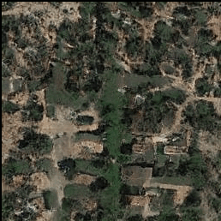
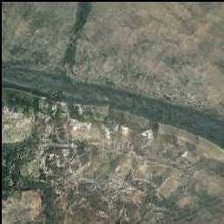
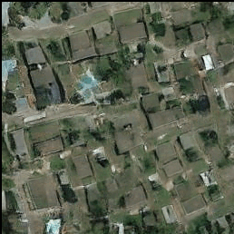
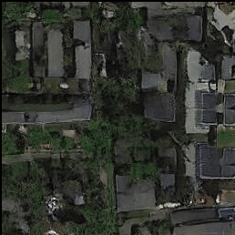
Urbanization direction: more results

